Slide 1
Generative Ai Enhanced Automation System Design Processes
Automated Presentation from Research Summary

Slide 2
Introduction
This work delves into the potential of applying Generative AI techniques to the system design phase.
The system design phase is pivotal in determining a system’s functionality, performance, and overall success.

Slide 3
Methodology
This paper introduces methods for system design using Gen AI to generate design information and discusses our discussion of the challenges of integrating Gen AI with Large Language Models (LLMs)
Traditional methods can be resource-intensive, time-consuming, and sometimes impractical for complexsys- tems.

Slide 4
Challenges
Integrating Gen AI into system design poses challenges.
The paper is published by Hitachi Ltd. and is published under the headline ‘How can Gen AI improve the efficiency and accuracy of system design in complex systems such as autonomous transportation, traffic networks, and cloud-based software systems?’
System Design Evaluation is essential in engineering to ensure proposed designs meet specifications, performance cri- teria, and safety standards.
These criteria include technical accuracy, compliance with standards, feasibility, innovation, and alignment with system require- ments.
The DesDoc provides the con- tent to be assessed, while the evaluation criteria establish the standards for assessment.
The SE Assistant expands these criteria by integrating industry standards, best practices, and insights from similar projects, ensuring they are comprehensive and reflect current industry trends.
Future work will enhance the SE Assistant to produce accurate Des Docs with robust LLMs ensuring high standards of technical accuracy and compliance.
Gen AI can improves the efficiency and accuracy of system design documentation in complex systems.

Slide 5
SE Assistant Tool
Gen AI is used to automate the creation of complex design elements and is emerging as a powerful tool for system engineers.
The SE Assistant is a tool for automating the creation of DesDocs.
The SE Assistant tool, com- bining GPT-4 with a M-RAG pipeline, significantly enhances the generation and evaluation of DesDocs for complex sys- tems.
It can also provide a valuable tool for system engineers.

Slide 6
Evaluation Process
By leveraging these powers, LLMs enable engineers to streamline design tasks, enhance creativity, and optimize system performance.
The ”Evaluation Criteria” are dynamically generated by.
The SE Assistant generates the DesDoc and the dynamically generated Evaluation Criteria.
Using multiple LLMs mitigates bias, and their outputs are combined into a weighted average score, forming the Evaluation Score.
Engineers’ evaluations ensure results align with human stan- dards and expectations, checking LLM evaluations.
While LLMs offer systematic, data-driven evaluations, hu- man engineers provide critical insights into practical aspects such as manufacturability, integration, and user experience.
In the procedural flow, LLMs provide initial evalua- tions, and a system engineer’s insights ensure robust, nuanced evaluation.

Slide 7
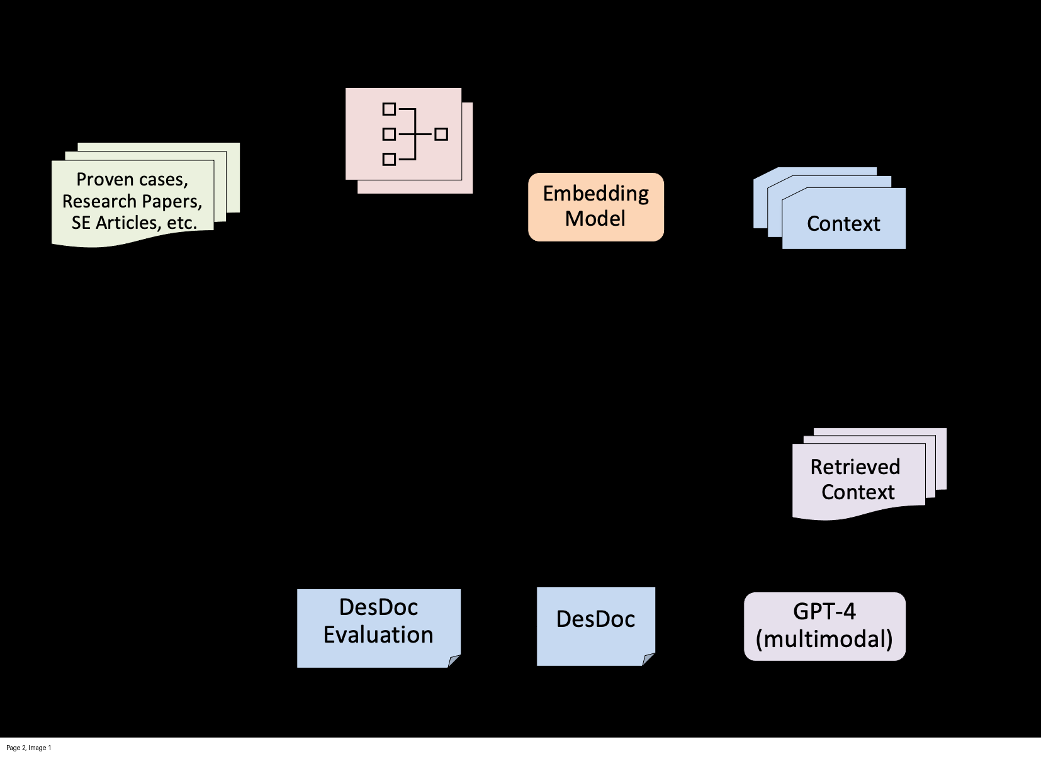

Slide 8
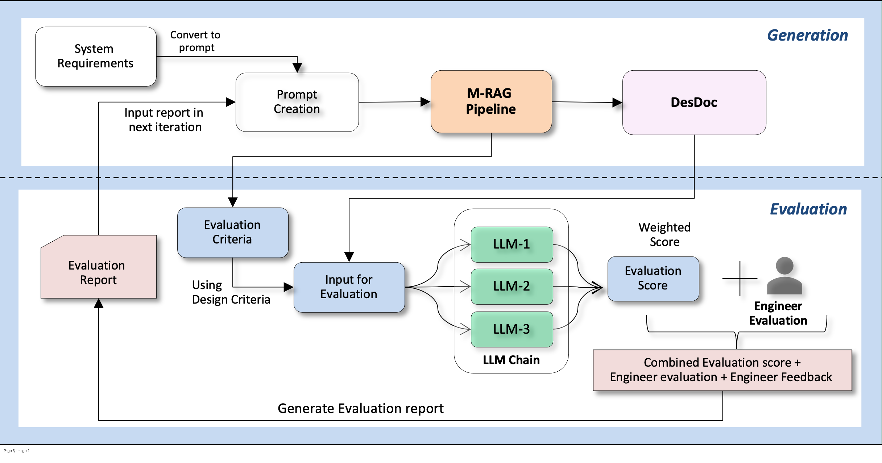

Slide 9
Thank You!
This PPT was generated by AI

